Slide 1
2D Pose Estimation On Sign Language Database
Ahmet Bağlan

Slide 2
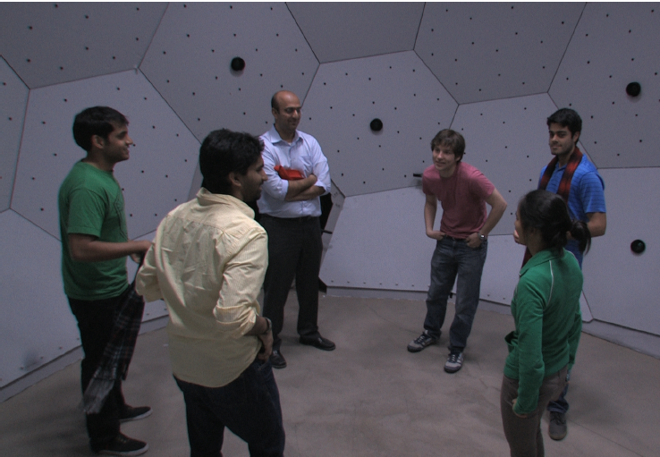
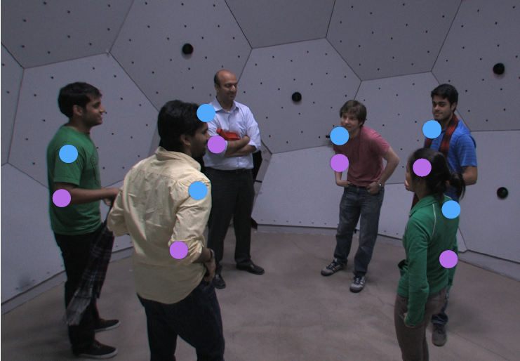
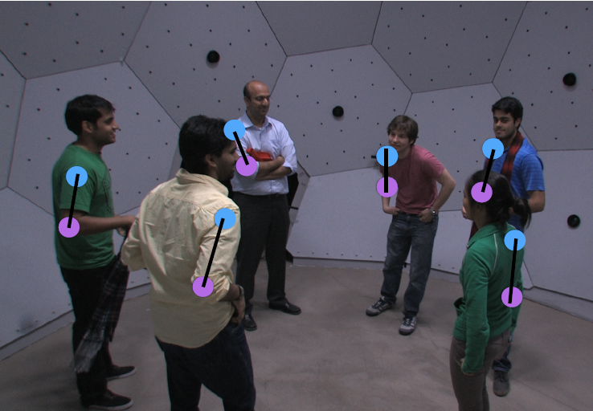
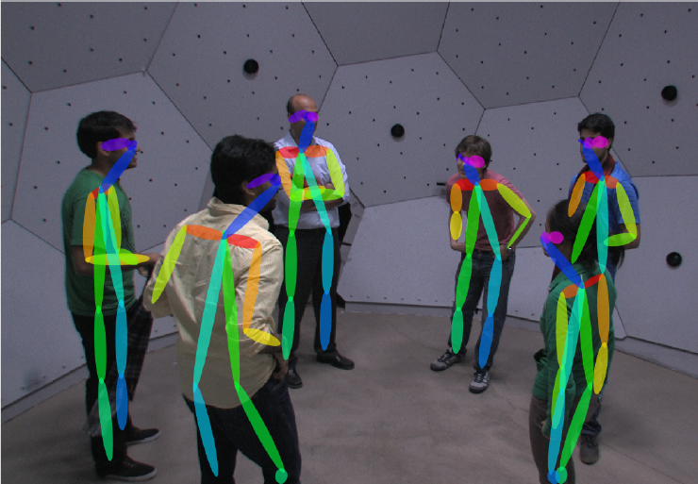
Problem
Notes:
The objective of this project is to design a system which can correctly localize body parts
in a sign language video using only RGB values without the use of depth information.

Slide 3
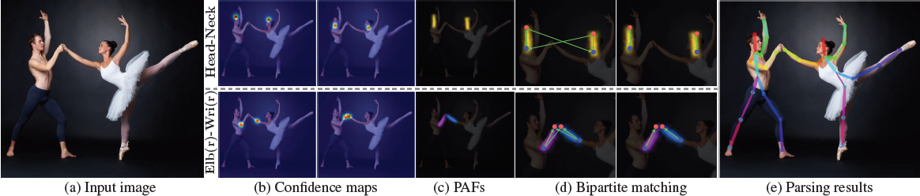
Method

Slide 4
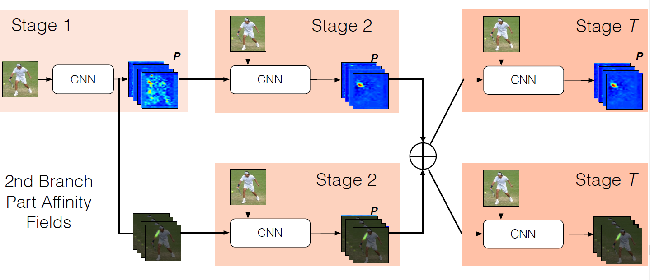
Method

Slide 5
Framework
Caffe is a deep learning framework made with expression, speed, and modularity in mind.
We are using the MATLAB interface of the architecture

Slide 6

Database

Slide 7
Results

Slide 8
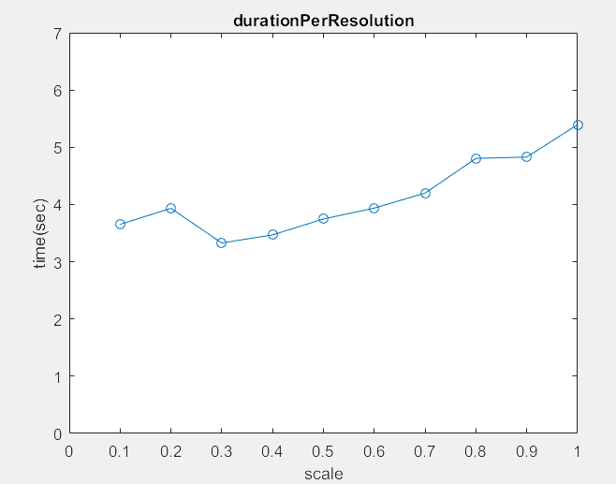
Effect Of Resolution

Slide 9
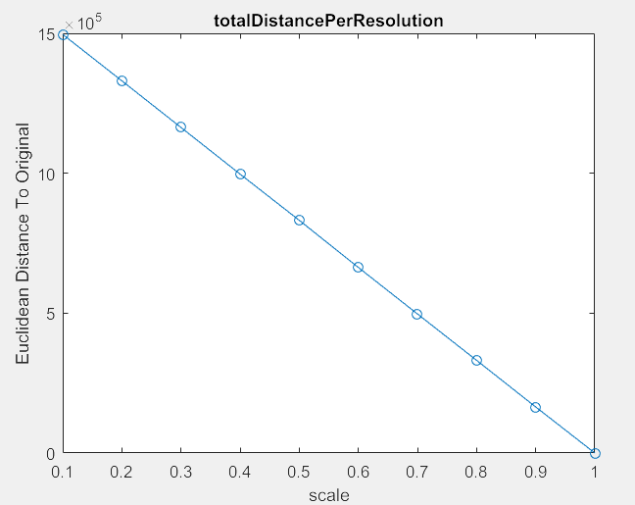
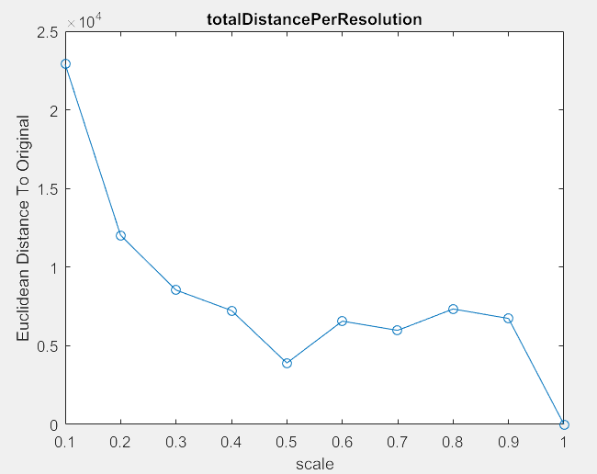
Effect Of Resolution

